Slide 1
Bezier Extraction

Slide 2
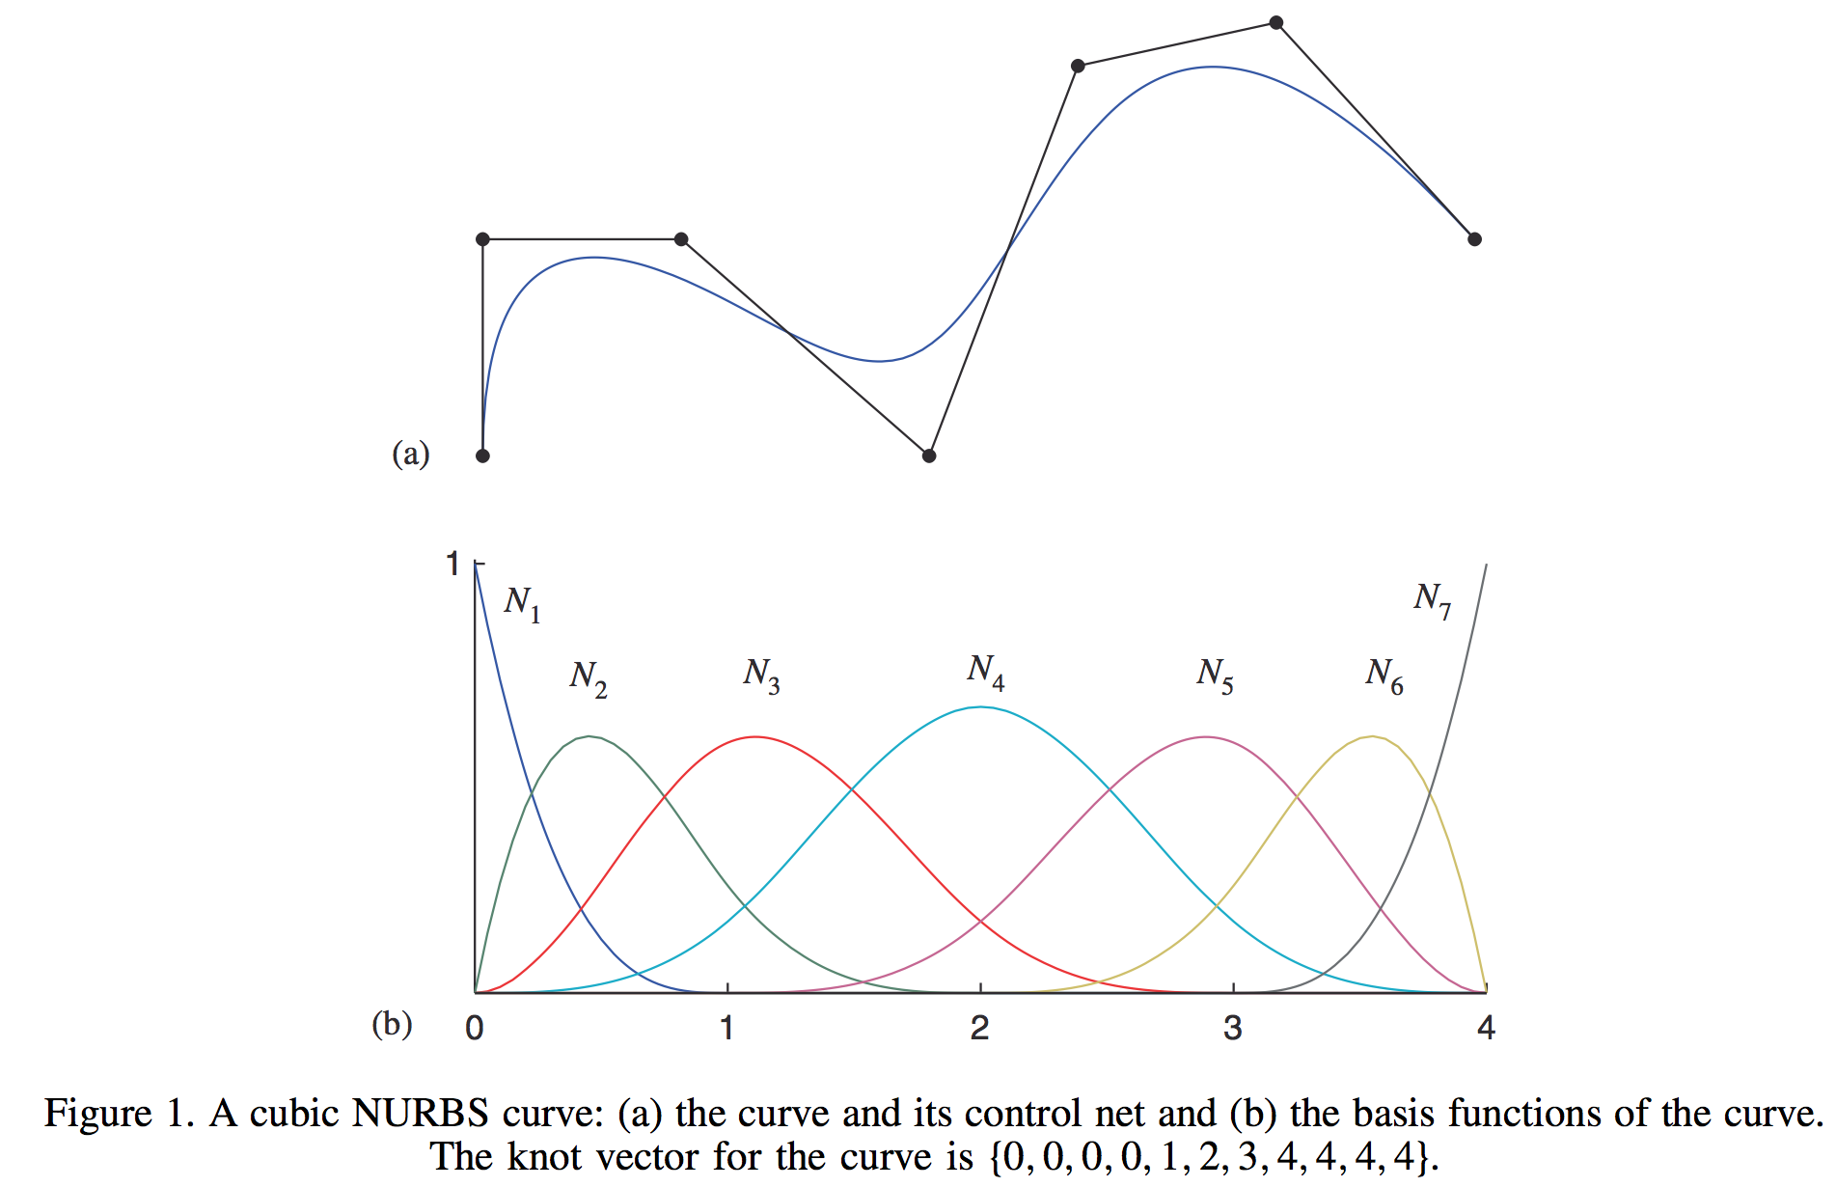

Slide 3
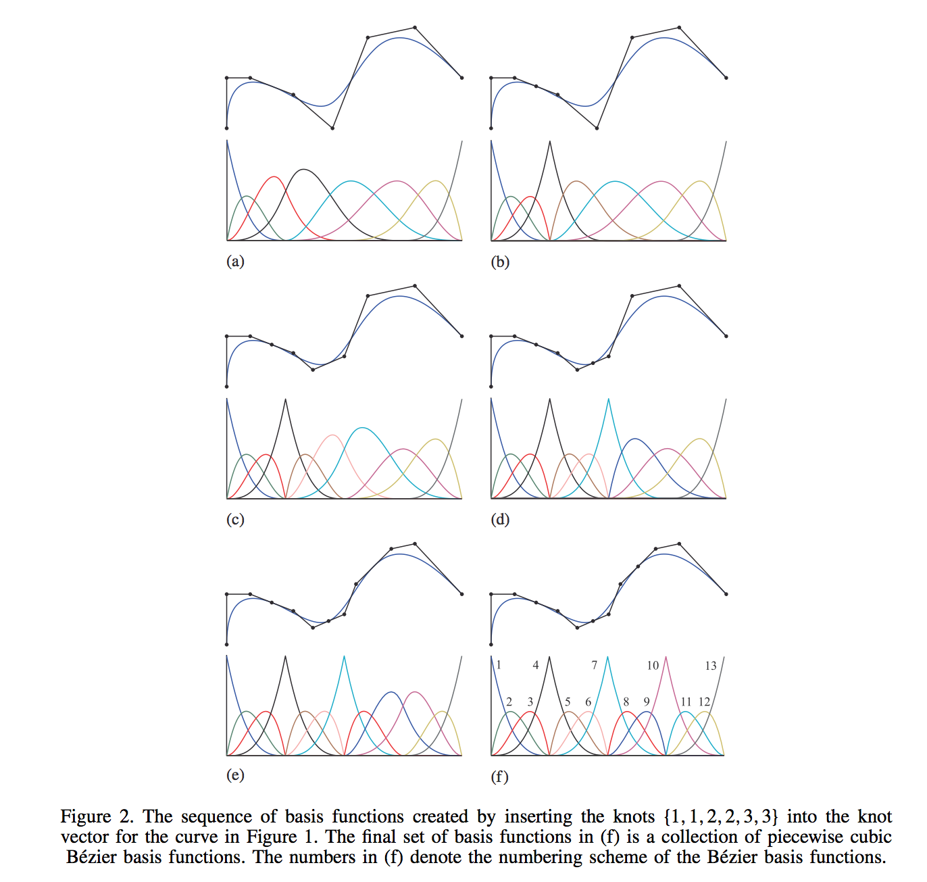

Slide 4
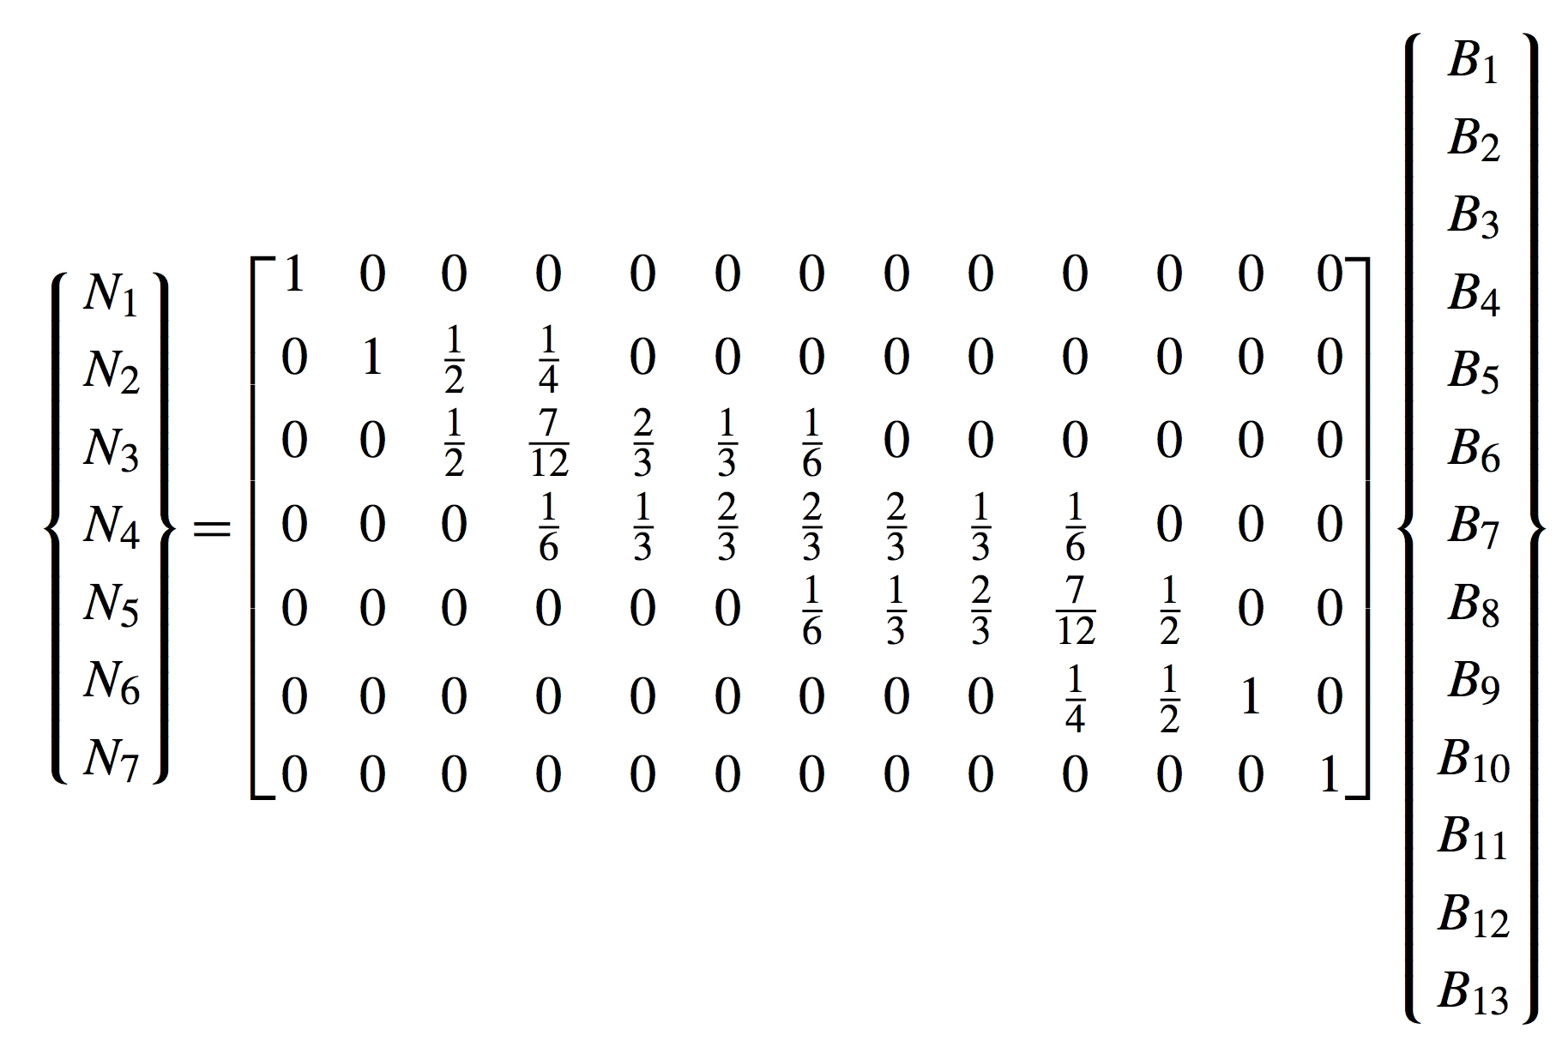

Slide 5
B-spline
Basis

Slide 6
Bernstein
Basis

Slide 7
Bezier Extraction
Operator

Slide 8
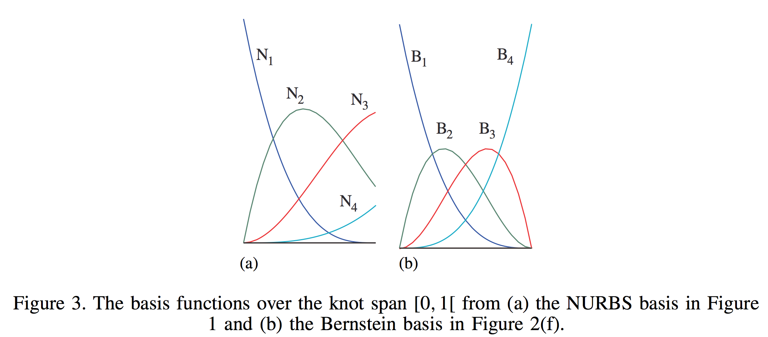
Localizing to the first nonempty knot span, or element:

Slide 9
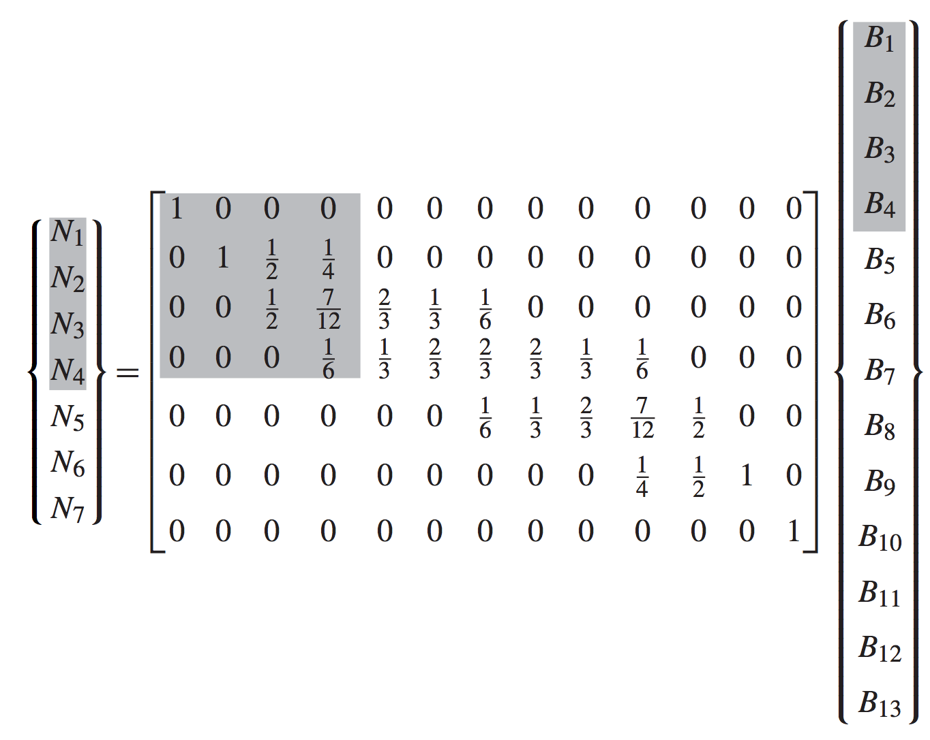
Localizing to the first element:

Slide 10
Localizing to the first element:
Local Element Extraction
Operator

Slide 11
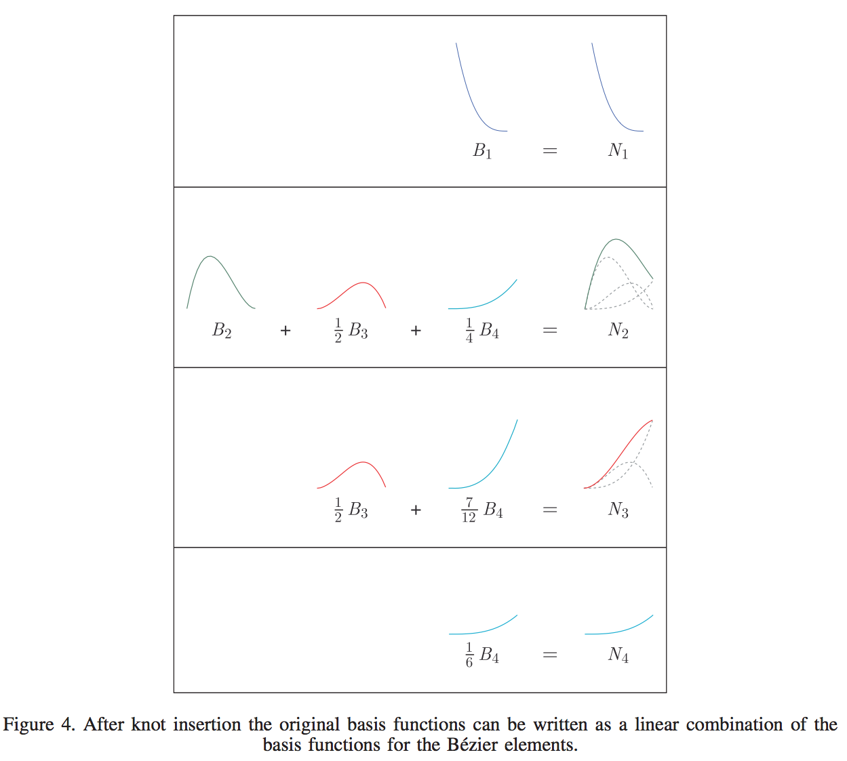

Slide 12
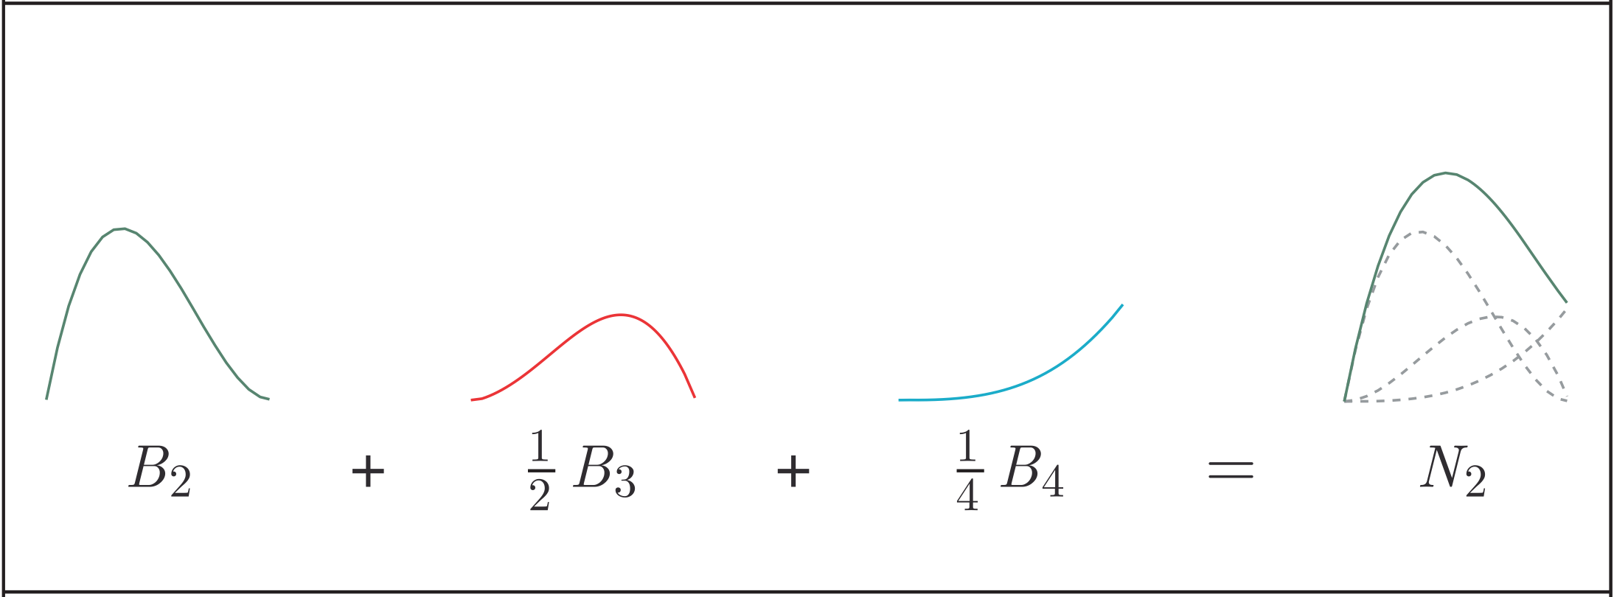

Slide 13
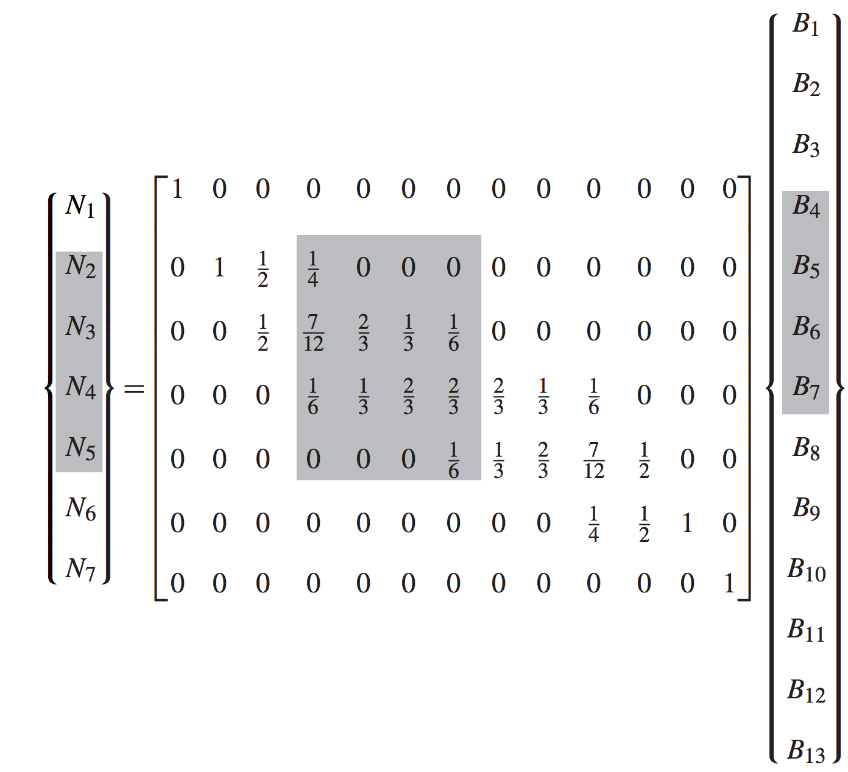
Localizing to the second element:

Slide 14
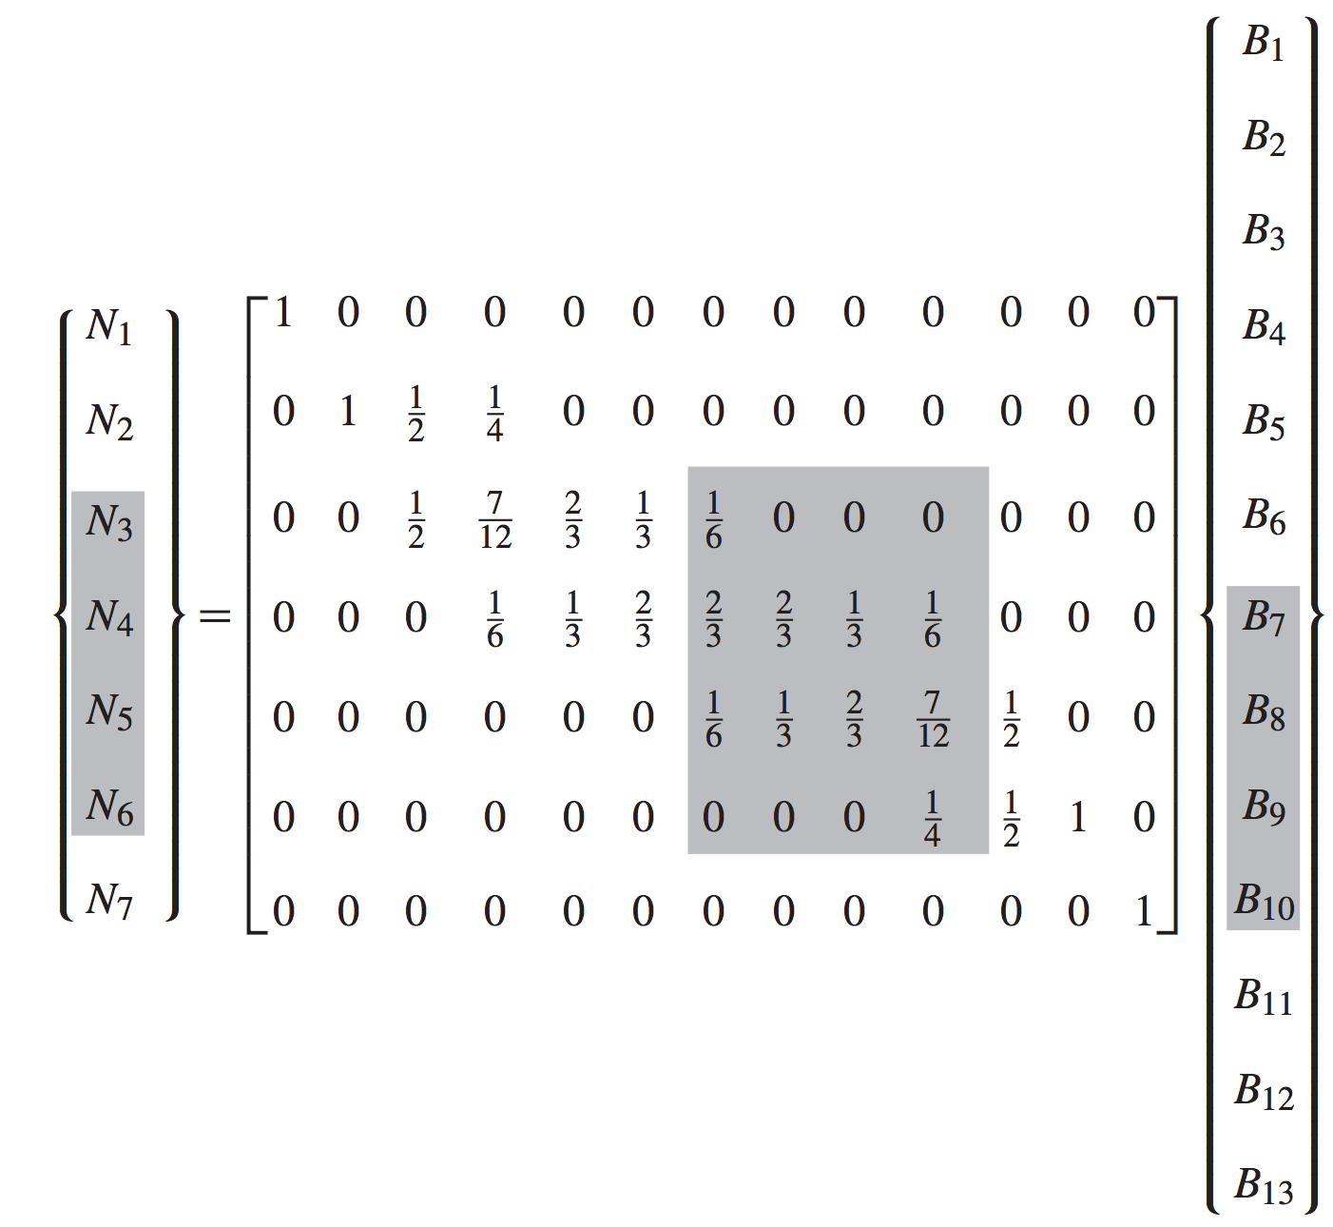
Localizing to the third element:

Slide 15
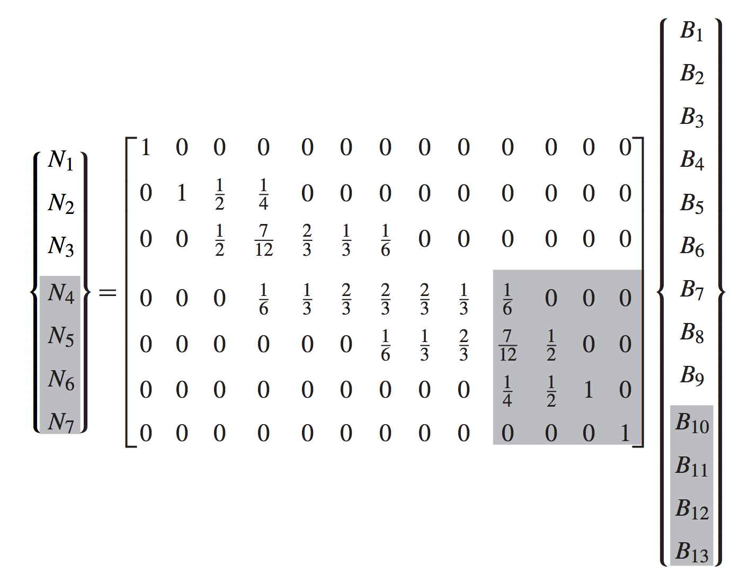
Localizing to the fourth element:

Slide 16
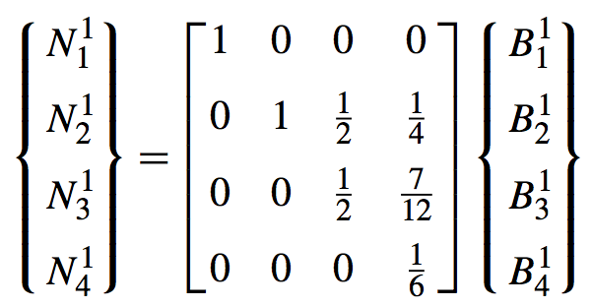
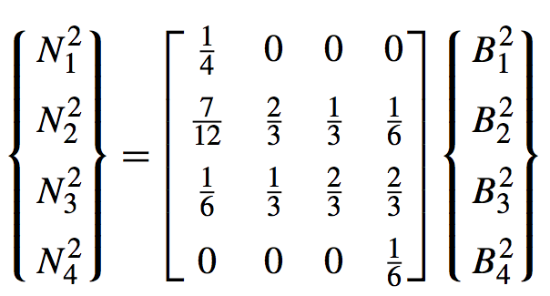
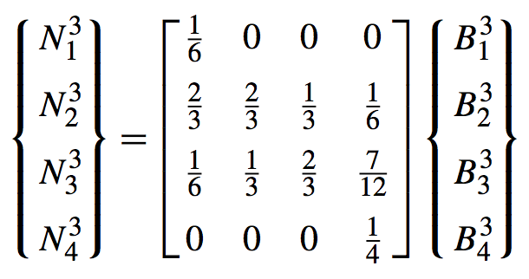
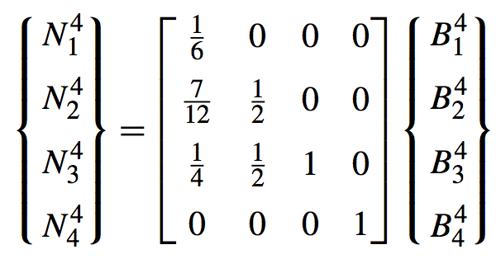

Slide 17
Localized Extraction
Operators

Slide 18
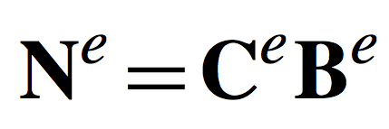

Slide 19
